Slide 2
What is a Component
COMPONENT = [HTML(JSX)+CSS+JS].
A component is a page or part of a HTML page.
You can have a component without CSS. You can have a component without any JS functionalities or actions. But you cannot have a component without a JSX.
Note: JS functionalities act on HTML(JSX) only. CSS also is applied to HTML only. So there is no scope or meaning in writing CSS or JS without HTML(JSX).
Only HTML can exist without CSS and JS.
Thus every component has to or must have to return JSX.The returned JSX is rendered in the browser.
You write a component only if have a JSX to be returned. If there is no JSX to be returned, we need not write components. We write only pure JS utility functions or classes.

Slide 3
Component Structure
Import statements:
To import the following that are used in the component.
Other components
Other libraries.
Data
Css files.
Other utility functions etc
Component definition
Class component.
Returns JSX through the render() only
Functional component.
Directly returns JSX without render() method.
Export statement:
If you want this coponent to be used in the other components through out the application, you have to export the component
If you don’t export the component, the component cannot be used in the other libraries.

Slide 4
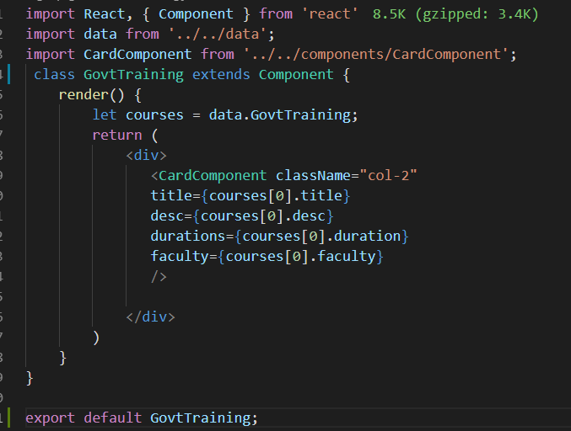
Class Component Syntaxes

Slide 5
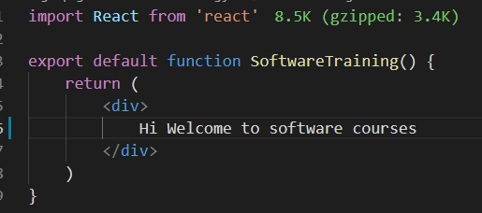
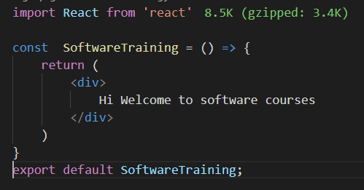
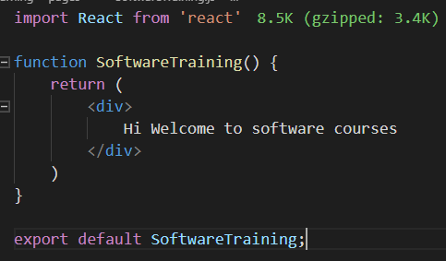
Functional Component Syntax

Slide 6
Differences between Class Components and Functional Components before React 16.8 v.
Class Component | Functional Component
1) Pure JS Class | Pure JS function
2) extends Component | No extentions
3) A render() is a must in the class component | We don’t have any reder() in functional components.
4) All the JSX is defined and returned from the render method. Syntax:- render(){return ( JSX )} | All the JSX is directly returned from the return method. Syntax:- return ( JSX )
5) Class Components can hold state. So calss components are called as statefull components. | They does not have state. Hence called as SFC(stateless functional components)
6) Have lifecycle methods called as sideeffects. Lifecycle methods are nothing but the methods which are called and perform some actions different times when a component is initialized to component is removed from the DOM. | Have no lifecycle methods or any sideeffects.

Slide 7
Class Component | Functional Component
7) It can change the status of a value or data through state by changing the state of a value or data. Class components can also receive data from its parent components by accepting props. In other words parent components can inject data into class components in the form of props. | In FC we cannot change the status of a value or data. It can only receive data from the parent component in the form of props. Functional components can also pass data to its child components by injecting data into them through props.
8) So class components are mostly used when you have to set different states(status) for particular values , to perform different actions during its lifecycle like fetching data, updating data, deleting data etc, manipulating data and passing data into its child components. | Functional components are mostly used only for displaying data and receive props from its parent components.

